Slide 1

OS for Database systems File System and Networking
1
Seehwan Yoo Dankook University
Disclaimer: Some slides are borrowed from UC. Berkeley’s 2014 OS and system programming.

Slide 2
목차
2
강의 개요
OS 이론 강의 (8/29~9/2)
OS 개론, 프로세스.
병렬성.
메모리, IPC.
+ mini 실습
+ mini 실습
+ mini 실습
파일시스템, 네트워킹. + mini 실습
클라우드 컴퓨팅 및 시스템 관리
OS 실습 강의 (9/19~9/23)
리눅스 개발 환경 구축 및 쉘 프로그래밍 (1d)
다중쓰레드 자료구조 실습 프로젝트 (2d)
AWS 실습 및 WordPress 기반 DB 실습 프로젝트 (2d)

Slide 3
Contents
3
Caching in OS
File System
Directory structure
inode structure
Networking
TCP/IP stack

Slide 4

Cache, where CA meets OS
4
Cache for performance
locate faster access memory, nearby cpu
larger memory takes 10x~100x times to access memory
e.g.) DRAM access time: 1ms, $ access time: 20us
Cache hit/miss
hit: data is in the $
hit ratio 90%, average memory access time?
90% * 20us + 10% * (1ms+20us) = 120us
CPU
$
Memory

Slide 5

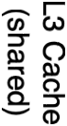
Memory hierarchy with multiple caches
5
Take advantage of the principle of locality to:
Present as much memory as in the cheapest technology
Provide access at speed offered by the fastest technology
Processor
Core
Secondary Storage (Disk)
Secondary Storage (SSD)
Main Memory (DRAM)
Core
Speed (ns):
0.3
1
3
10-30
100
100,000
(0.1 ms)
10,000,000
(10 ms)
Size (bytes): 100Bs 10kBs
D1a0n0kokoBksUniver^{M}sit^{B}y ^{s}
GBs
100GBs
TBs

Slide 6


Why Does Caching Work? Locality!
6
Temporal Locality (Locality in Time):
Keep recently accessed data items closer to processor
Spatial Locality (Locality in Space):
Move contiguous blocks to the upper levels
Probability of reference
0
Address Space
2^{n} - 1
Lower Level Memory
To Processor
Upper Level Memory
Blk X
From Processor
Blk Y

Slide 7
Design issues for caches
7
In Computer Architecture we are focused on cache design as a transparent memory accelerator
reduce average MAT (latency), increase BW
implemented directly in hardware
Issues:
cache size
block size
associativity (direct mapped, set assoc, fully assoc)
placement, replacement
number of levels of caches
trade-offs among all of these

Slide 8
Direct Mapped Cache
8
Cache index selects a cache block
“Byte select” selects byte within cache block
Example: Block Size=32B blocks
Cache tag fully identifies the cached data
Data with same “cache index” shares the same cache entry
Conflict misses
31
8
4
0
Cache Tag | Cache Index | Byte Select
Ex: 0x01
Cache Data
Cache Tag
Valid Bit
Byte 31 Byte 1 Byte 0
Byte 63 Byte 33 Byte 32
:
:
:
:
:
Compare
Hit

Slide 9
Fully Associative Cache
9
Fully Associative: Every block can hold any line
Address does not include a cache index
Compare Cache Tags of all Cache Entries in Parallel
Example: Block Size=32B blocks
We need N 27-bit comparators
Still have byte select to choose from within block
31
4
0
Cache Tag (27 bits long)
Byte Select
Ex: 0x01
Cache Tag
Valid Bit
Cache Data
=
Byte 31 | : | Byte 1 | Byte 0
Byte 63 | : | Byte 33 | Byte 32
:
=
=
=
:
:
=

Slide 10
Set Associative Cache
10
N-way set associative: N entries per Cache Index
N direct mapped caches operates in parallel
31
8
4
0
Cache Tag
Cache Index
Byte Select
Valid
Cache Tag
Cache Data
Cache Data
Cache Tag
Valid
Cache Block 0
Cache Block 0
Example: Two-way set associative cache
:
:
:
:
:
:
Two tags in the set are compared to input in parallel
Data is selected based on the tag result
Compare
Sel1 ¹
Mux
⁰ Sel0
Compare
OR
Hit
Cache Block

Slide 11
Sources of Cache Misses
11
Compulsory (cold start): first reference to a block
“Cold” fact of life: not a whole lot you can do about it
Note: When running “billions” of instruction, Compulsory Misses are insignificant
Capacity:
Cache cannot contain all blocks access by the program
Solution: increase cache size
Conflict (collision):
Multiple memory locations mapped to same cache location
Solutions: increase cache size, or increase associativity
Two others:
Coherence (Invalidation): other process (e.g., I/O) updates memory
Policy: Due to non-optimal replacement policy

Slide 12
Cache Design Issues
12
Organization
cache size, block size
1-way, n-way, associative
Write Policy
write-through, write-back
Replacement policy
given n-way associativity, which of the n gets replaced
FIFO, Random, LRU, Clock
Coherence Policy (multi-processor)
write-invalidate, write-update

Slide 13
Caching Applied to Address Translation
13
Question is one of page locality: does it exist?
Instruction accesses spend a lot of time on the same page (since accesses sequential)
Stack accesses have definite locality of reference
Data accesses have less page locality, but lots
Each TLB entry is for a whole page of blocks !!!
TLB
Cached?
Yes
No
Virtual Address
Physical Address
Physical Memory
CPU
Save
Result
Translate (MMU)
Data Read or Write (untranslated)

Slide 14
Where does caching arise in Operating Systems ?
14

Slide 15
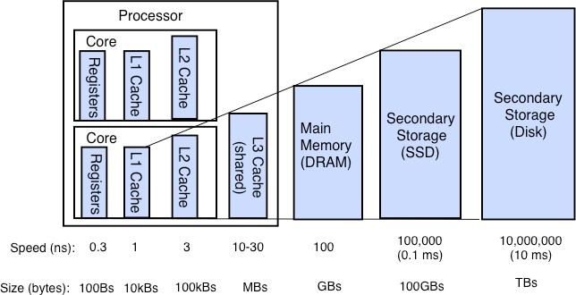
Hardware Design Trade-offs
15

Slide 16
Where does caching arise in Operating Systems ?
16
Direct use of caching techniques
paged virtual memory (mem as cache for disk)
TLB (cache of PTEs)
file systems (cache disk blocks in memory)
DNS (cache hostname => IP address translations)
Web proxies (cache recently accessed pages)
Which pages to keep in memory?

Slide 17
Where does caching arise in Operating Systems ?
17
Indirect - dealing with cache effects
Process scheduling
which and how many processes are active ?
large memory footprints versus small ones ?
priorities ?
Impact of thread scheduling on cache performance
rapid interleaving of threads (small quantum) may degrade cache performance
increase ave MAT !!!
Designing operating system data structures for cache performance

Slide 18
Where does caching arise in Operating Systems ?
18
Maintaining the correctness of various caches
TLB consistent with PT across context switches ?
Across updates to the PT ?
Shared pages mapped into VAS of multiple processes ?

Slide 19

























Working Set Model
19
As a program executes it transitions through a sequence of “working sets” consisting of varying sized subsets of the address space
Address
Time

Slide 20


Cache Behavior under WS model
20
Amortized by fraction of time the WS is active
Transitions from one WS to the next
Capacity, Conflict, Compulsory misses
Applicable to memory caches and pages. Others ?
1
Hit Rate
new working set fits
0
Cache Size

Slide 21
Another model of Locality: Zipf
21
Likelihood of accessing item of rank r is α1/rª
Although rare to access items below the top few, there are so many that it yields a “heavy tailed” distribution.
Substantial value from even a tiny cache
Substantial misses from even a very large one
P access(rank) = 1/rank
20%
1
18%
0.9
Popularity (% accesses)
16%
0.8
Estimated Hit Rate
14%
0.7
12%
0.6
10%
pop a=1
Hit Rate(cache)
0.5
8%
0.4
6%
0.3
4%
0.2
2%
0.1
0%
0
1 3 5 7 9 11 13 15 17 19 21 23 25 27 29 31 33 35 37 39 41 43 45 47 49
Rank

Slide 22
What Actually Happens on a TLB Miss?
22
Hardware traversed page tables:
On TLB miss, hardware in MMU looks at current page table to fill TLB (may walk multiple levels)
If PTE valid, hardware fills TLB and processor never knows
If PTE marked as invalid, causes Page Fault, after which kernel decides what to do afterwards
Software traversed Page tables
On TLB miss, processor receives TLB fault
Kernel traverses page table to find PTE
If PTE valid, fills TLB and returns from fault
If PTE marked as invalid, internally calls Page Fault handler
Most chip sets provide hardware traversal
Modern operating systems tend to have more TLB faults since they use translation for many things

Slide 23
What happens on a Context Switch?
23
Need to do something, since TLBs map virtual addresses to physical addresses
Address Space just changed, so TLB entries no longer valid!
Options?
Invalidate TLB: simple but might be expensive
What if switching frequently between processes?
Include ProcessID in TLB
This is an architectural solution: needs hardware
What if translation tables change?
For example, to move page from memory to disk or vice versa…
Must invalidate TLB entry!
Otherwise, might think that page is still in memory!

Slide 24
What TLB organization makes sense?
24
Needs to be really fast
Critical path of memory access
TLB
Cache
Memory
CPU
Seems to argue for Direct Mapped or Low Associativity
However, needs to have very few conflicts!
With TLB, the Miss Time extremely high!
This argues that cost of Conflict (Miss Time) is much higher than slightly increased cost of access (Hit Time)
Thrashing: continuous conflicts between accesses
What if use low order bits of page as index into TLB?
First page of code, data, stack may map to same entry
Need 3-way associativity at least?
What if use high order bits as index?
TLB mostly unused for small programs

Slide 25
TLB organization: include protection
25
How big does TLB actually have to be?
Usually small: 128-512 entries
Not very big, can support higher associativity
TLB usually organized as fully-associative cache
Lookup is by Virtual Address
Returns Physical Address + other info
What happens when fully-associative is too slow?
Put a small (4-16 entry) direct-mapped cache in front
Called a “TLB Slice”
When does TLB lookup occur relative to memory cache access?
Before memory cache lookup?
In parallel with memory cache lookup?

Slide 26
Reducing translation time further
26
As described, TLB lookup is in serial with cache lookup:
Virtual Address
10
V page no.
offset
TLB Lookup
V | Access Rights | PA
P page no. offset 10
Physical Address
Machines with TLBs go one step further: they overlap TLB lookup with cache access.
Works because offset available early

Slide 27
Overlapping TLB & Cache Access (1/2)
27
Main idea:
Offset in virtual address exactly covers the “cache index” and “byte select”
Thus can select the cached byte(s) in parallel to perform address translation
virtual address
physical address
Virtual Page # | Offset
tag / page # | index | byte

Slide 28
Overlapping TLB & Cache Access (1/2)
28
Here is how this might work with a 4K cache:
What if cache size is increased to 8KB?
Overlap not complete
Need to do something else.
TLB
assoc lookup
4K Cache
4 bytes
32
index
1 K
20
10 2
page # | disp | 00
Hit/ Miss
PA
=
PA
Data
Hit/ Miss

Slide 29
Putting Everything Together: Address Translation
29
Virtual Address:
Virtual P1 index | Virtual P2 index | Offset
Physical Memory:
PageTablePtr
Physical Address:
Physical
Page #
Offset
Page Table (1st level)
Page Table (2nd level)

Slide 30
Putting Everything Together: TLB
30
Virtual Address:
Virtual P1 index | Virtual P2 index | Offset
Physical Memory:
PageTablePtr
Page Table (1st level)
Page Table (2nd level)
Physical Address:
Physical
Page #
Offset
TLB:
…

Slide 31
Putting Everything Together: Cache
31
Physical Memory:
Virtual Address:
Virtual Virtual _{Offset} P1 index P2 index
PageTablePtr
Page Table (1st level)
Page Table (2nd level)
TLB:
…
Physical Address:
Physical
Page #
Offset
tag
index
byte
cache: tag:
block:
…

Slide 32
Some more on Caching in OS
32
Buffer cache
in-storage data (in the medium) can be cached in
in-storage memory: HDD, SSD has DRAM within the device!
in-main memory: main memory can cache, reducing I/O
in-CPU: on the CPU cache
we will revisit this in later chapter!
DMA
mem-device transfer without CPU intervention
mem-cpu-device transfer could use CPU cache
DMA works with physical address (bus address)
DMA-transferred data is not stored on CPU cache
If your data is on the CPU cache, and DMA overwrites it?
you see stale data; page table entry has cacheable flag
If it is not set, the page address is not cacheable (e.g. MMIO region)

Slide 33
TLB and Cache size
33
CPUs have TLB and Cache
TLB size: only a few KB
Cache size: tens of MB
why they are so different in size?
single TLB entry (8Bytes) can cover up to 4KB memory region
However, single cacheline (64Bytes) can cover 64 Bytes
To cover 4KB memory region (footprint),
you may need single TLB entry, and 4KB data store in cache

Slide 34
File System Design
34

Slide 35


Components of a File System
35
Directory structure
File structure
File path
Directory Structure
File Index Structure
Data
Meta-data
Data for data
Data that describes data
Property
E.g.) filename, size
are not the data in the file
File number
Data blocks
…

Slide 36
Components of a file system
36
file name offset
file number offset
Storage block
directory
index structure
Open performs name resolution
Translates pathname into a “file number”
Used as an “index” to locate the blocks
Creates a file descriptor in PCB within kernel
Returns a “handle” (another int) to user process
Read, Write, Seek, and Sync operate on handle
Mapped to descriptor and to blocks

Slide 37
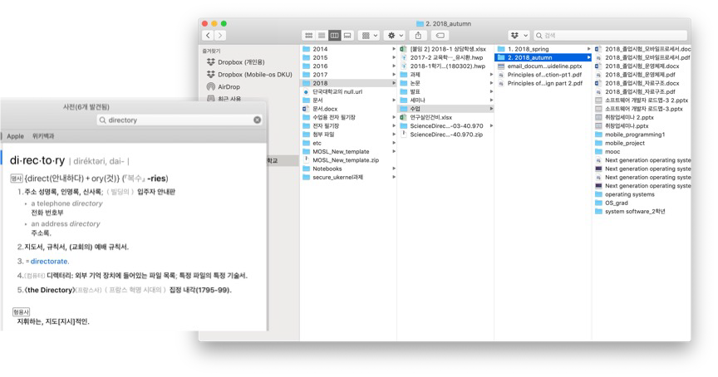
Directories
37
Hierarchical structure of files
Files are in a directory
Directory is a file
List of files at the same hierarchy level

Slide 38
Directory
38
Basically a hierarchical structure
Each directory entry is a collection of
Files
Directories
A link to another entries
Each has a name and attributes
Files have names, sizes, created dates, etc.
Links (hard links) make it a DAG, not just a tree
Softlinks (aliases) are another name for an entry

Slide 39

File
39
Named permanent storage
Contains
Data
Blocks on disk somewhere
Metadata (Attributes)
Owner, size, last opened, …
Access rights
R, W, X
Owner, Group, Other (in Unix systems)
Access control list in Windows system
Data blocks
File handle
…
File descriptor
Fileobject (inode) Position

Slide 40

FAT (File Allocation Table)
40
Assume (for now) we have a way to translate a path to a “file number”
i.e., a directory structure
Disk Storage is a collection of Blocks
Just hold file data
Example: file_read 31, < 2, x >
Index into FAT with file number
Follow linked list to block
Read the block from disk into mem
FAT
Disk Blocks
file number
0:
0:
File 31 , Block 0
File 31 , Block 1
File 31 , Block 2
31:
mem
N-1:
N-1:

Slide 41




FAT (File Allocation Table)
41
File is collection of disk blocks
FAT is linked list 1-1 with blocks
File Number is index of root of block list for the file
File offset (o = B:x )
Follow list to get block #
Unused blocks <= FAT free list
FAT
Disk Blocks
0:
0:
File 31 , Block 0
File 31 , Block 1
File 31 , Block 3
File 31 , Block 2
file number
31:
free
mem
N-1:
N-1:

Slide 42




FAT (File Allocation Table)
42
File is collection of disk blocks
FAT is linked list 1-1 with blocks
File Number is index of root of block list for the file
File offset (o = B:x )
Follow list to get block #
Unused blocks <= FAT free list
Example: file_write(51, <3, y> )
FAT
Disk Blocks
0:
0:
File 31 , Block 0
File 31 , Block 1
File 31 , Block 3
File 31 , Block 2
file number
31:
free
mem
N-1:
N-1:

Slide 43
FAT (File Allocation Table)
43
File is collection of disk blocks
FAT is linked list 1-1 with blocks
File Number is index of root of block list for the file
File offset (o = B:x )
Follow list to get block #
Unused blocks <= FAT free list
Grow file by allocating free blocks and linking them in
FAT
Disk Blocks
0:
0:
File 31 , Block 0
File 31 , Block 1
File 31 , Block 3
File 31 , Block 2
file number
31:
free
mem
N-1:
N-1:

Slide 44





FAT (File Allocation Table)
44
File is collection of disk blocks
FAT is linked list 1-1 with blocks
File Number is index of root of block list for the file
Grow file by allocating free blocks and linking them in
Example Create file, write, write
FAT
Disk Blocks
0:
0:
File 31 , Block 0
File 31 , Block 1
File 17 , Block 1
File 31 , Block 3
File 17 , Block 0
File 31 , Block 2
file number
31:
File 2 number
free
mem
N-1:
N-1:

Slide 45









FAT Assessment
45
Used in DOS, Windows, thumb drives, …
Where is FAT stored ?
On Disk, restore on boot, copy in memory
What happens when you format a disk?
Zero the blocks, link up the FAT free
Simple
FAT
Disk Blocks
0:
free
31:
file number
0:
File 31 , Block 0
File 31 , Block 1
File 17 , Block 1
File 31 , Block 3
File 17 , Block 0
File 31 , Block 2
file 2 number
N-1:
N-1:

Slide 46









FAT Assessment
46
Time to find block (large files) ??
Free list usually just a bit vector
Next fit algorithm
FAT
Disk Blocks
0:
free
31:
file number
0:
Block layout for file ???
Sequential Access ???
Random Access ???
Fragmentation ???
Small files ???
Big files ???
File 31 , Block 0
File 31 , Block 1
File 17 , Block 1
File 31 , Block 3
file 2 number
File 17 , Block 0
File 31 , Block 2
N-1:
N-1:

Slide 47
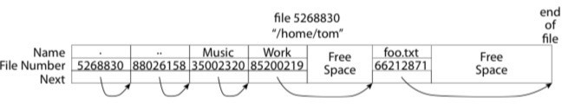
What about the Directory?
47
Essentially a file containing
<file_name: file_number> mappings
Free space for new entries
In FAT: attributes kept in directory (!!!)
Each directory a linked list of entries
Where do you find root directory ( “/” )

Slide 48

Bit more on directories
48
Stored in files, can be read, but don’t
System calls to access directories
Open / Creat traverse the structure
mkdir /rmdir add/remove entries
Link / Unlink
Link existing file to a directory
/usr
/usr/lib
/usr/lib4.3
Not in FAT !
Forms a DAG
libc support
DIR * opendir (const char *dirname)
struct dirent * readdir (DIR *dirstream)
/usr/lib/foo
/usr/lib4.3/foo
int readdir_r (DIR *dirstream, struct dirent *entry, struct dirent **result)

Slide 49

When can a file be deleted ?
49
Maintain reference count of links to the file.
Delete after the last reference is gone.
/usr
/usr/lib
/usr/lib4.3
/usr/lib/foo
/usr/lib4.3/foo

Slide 50
Big FAT security holes
50
FAT has no access rights
FAT has no header in the file blocks
Just gives and index into the FAT
(file number = block number)

Slide 51
Unix File System
51

Slide 52
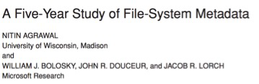
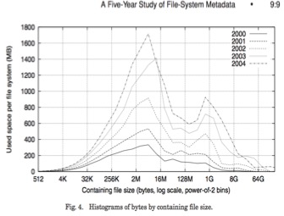
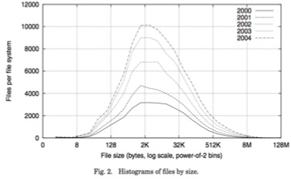
Characteristics of Files
52
Most files are small
Most of the space is occupied by the rare big ones

Slide 53
So what about a “real” file system
53
Meet the inode
Inode Array
Triple Indirect Blocks
Double Indirect Blocks
Indirect Blocks
Data Blocks
Inode
file_number
File Metadata
...
...
Direct Pointers
...
...
...
...
...
...
...
Indirect Pointer Dbl. Indirect Ptr. Tripl. Indrect Ptr.
...
...
...
...
... ...
...

Slide 54
Unix File System
54
File Number is index into inode arrays
Multi-level index structure
Great for little to large
Asymmetric tree with fixed sized blocks
Metadata associated with the file
Rather than in the directory that points to it
Locality Heuristics
Block group placement
Reserve space
Scalable directory structure

Slide 55
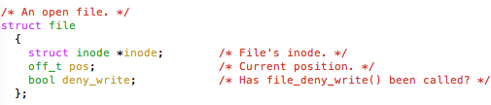
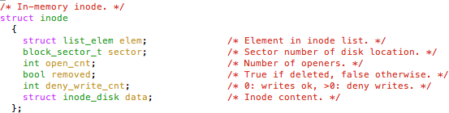
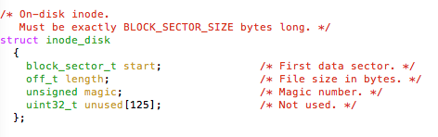
An “almost real” file system
55
Pintos: src/filesys/file.c, inode.c

Slide 56

UFS: File Attributes
56
Inode has metadata
Inode Array
Triple Indirect Blocks
Double Indirect Blocks
Indirect Blocks
Data Blocks
Inode
File Metadata
...
User Group
...
Direc
Pointe
Indirect Poi Dbl. Indirect Tripl. Indrect
t rs
...
...
9 basic access control bits
UGO x RWX
Setuid bit
execute at owner permissions
rather than user Getgid bit
execute at group’s permissions
...
...
...
...
...
nter
Ptr. Ptr.
...
...
...
...
... ...
...

Slide 57

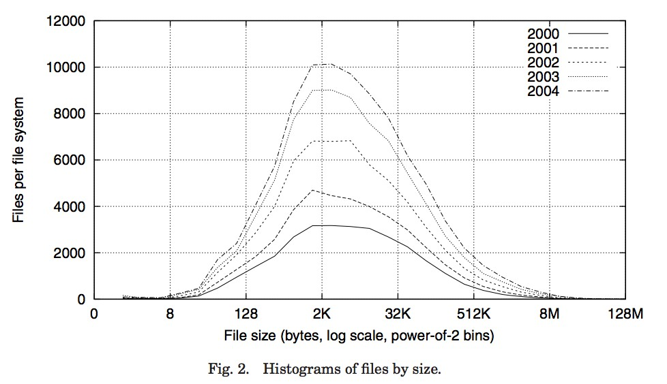
UFS: Data Storage
57
Small files: 12 pointers direct to data blocks
Direct pointers
Inode Array
Triple Indirect
Inode Blocks
Double Indirect Blocks
Indirect Blocks
Data Blocks
With 4kB blocks, sufficient For files up to 48KB
File Metadata
...
...
Direct Pointers
...
...
...
...
...
...
...
Indirect Pointer Dbl. Indirect Ptr. Tripl. Indrect Ptr.
...
...
...
...
... ...
...

Slide 58
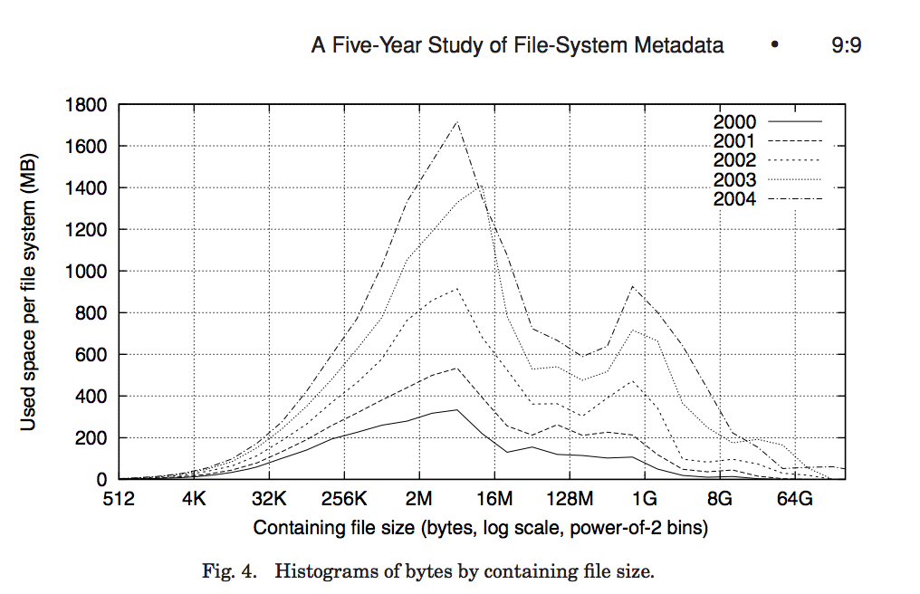


UFS: Data Storage
58
Large files: 1,2,3 level indirect pointers
Indirect pointers
point to a disk block containing only pointers
eg. 4 kB blocks => 1024 pointers
=> 4 MB @ level 2
=> 4 GB @ level 3
=> 4 TB @ level 4
Triple Indirect Blocks
Double Indirect Blocks
Inode Array
File Metadat
Indirect Blocks
Data Blocks
Inode
a
...
48 KB
...
+4 MB
Direct Pointers
...
...
...
+4 GB
...
...
...
...
Indirect Pointer Dbl. Indirect Ptr. Tripl. Indrect Ptr.
...
...
...
...
... ...
...
+4 TB

Slide 59
Freespace Management
59
Bit vector with a bit per storage block
Stored at a fixed location within the file system

Slide 60
Where are inodes stored?
60
In early UNIX and DOS/Windows’ FAT file system, headers stored in special array in outermost cylinders
Header not stored anywhere near the data blocks.
To read a small file, seek to get header, seek back to data.
Fixed size, set when disk is formatted.
At formatting time, a fixed number of inodes were created (They were each given a unique nu mber, called an “inumber”)

Slide 61
Where are inodes stored?
61
Later versions of UNIX moved the header information to be closer to t he data blocks
Often, inode for file stored in same “cylinder group” as parent directory of the f ile
(makes an ls of that directory run fast).
Pros:
UNIX BSD 4.2 puts a portion of the file header array on each of many cylinders. For small directorie s, can fit all data, file headers, etc. in same cylinder ⇒ no seeks!
File headers much smaller than whole block (a few hundred bytes), so multiple headers fetched fro m disk at same time
Reliability: whatever happens to the disk, you can find many of the files (even if directories disconne cted)
Part of the Fast File System (FFS)
General optimization to avoid seeks

Slide 62
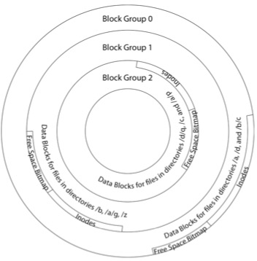
FastFileSystem considers Locality: Block Groups ⁶²
File system volume is divided into a set of bloc k groups
Close set of tracks
File data blocks, metadata, and free space are interleaved within block group
Avoid huge seeks between user data and system str ucture
Put directory and its files in common block gro up
First-Free allocation of new file block
Few little holes at start, big sequential runs at end o f group
Avoids fragmentation
Sequential layout for big
Reserve space in the BG

Slide 63
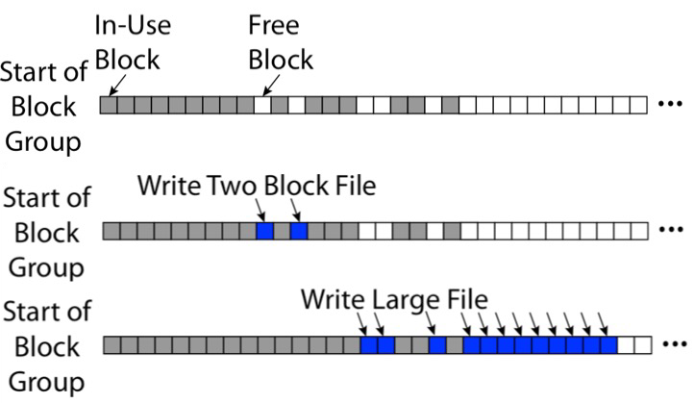
FFS First Fit Block Allocation
63
Fills in the small ho les at the
start of block group
Avoids fragmentati on,
leaves contiguous free space at end

Slide 64
FFS
64
Pros
Efficient storage for both small and large files
Locality for both small and large files
Locality for metadata and data
Cons
Inefficient for tiny files (a 1 byte file requires both an inode and a data bloc k)
Inefficient encoding when file is mostly contiguous on disk (no equivalent to superpages)
Need to reserve 10-20% of free space to prevent fragmentation

Slide 65

Large Directories: B-Trees
65
Search for hash(”out2”) = 0x0000c194
B+Tree Root
Before Child Pointer
00ad1102
b0bf8201
...
cff1a412
B+Tree Node
B+Tree Node
B+Tree Node
Before Child Pointer
0000 | c195 | 00018201 |  | ...
...
B+Tree Leaf
B+Tree Leaf
B+Tree Leaf
Hash Entry Pointer
0000a0d1
0000b971
...
0000c194
...
Name File Number
. | .. | file1 | file2 | ... | file9841 | out1 | out2 | ... | out16341
36210429 | 983211 | 239341 | 231121 | ... | 243212 | 841013 | 841014 | ... | 324114
“out2” is file 841014

Slide 66
NTFS
66
Master File Table
Flexible 1KB storage for metadata and data
Variable-sized attribute records (data or metadata)
Extend with variable depth tree (non-resident)
Extents ­ variable length contiguous regions
Block pointers cover runs of blocks
Similar approach in linux (ext4)
File create can provide hint as to size of file
Journalling for reliability
Discussed next week

Slide 67
NTFS Small File
67
Master File Table
Create time, modify time, access time,
Owner id, security specifier, flags (ro, hid, sys)
data attribute
MFT Record (small file)
Std. Info.
File Name
Data (resident)
(free)
Attribute list

Slide 68
NTFS Medium File
68
Start
Master File Table
Length
+
Data Extent
MFT Record
Start + Length
Std. Info.
File Name
Data (nonresident)
(free)
Start
Length
Data Extent
Start + Length

Slide 69
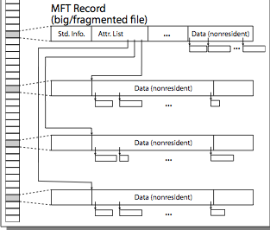
NTFS Multiple Indirect Blocks
69

Slide 70
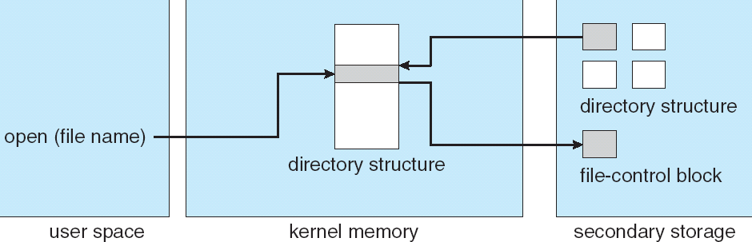
In-Memory File System Structures
70
Open system call:
Resolves file name, finds file control block (inode)
Makes entries in per-process and system-wide tables
Returns index (called “file handle”) in open-file table

Slide 71
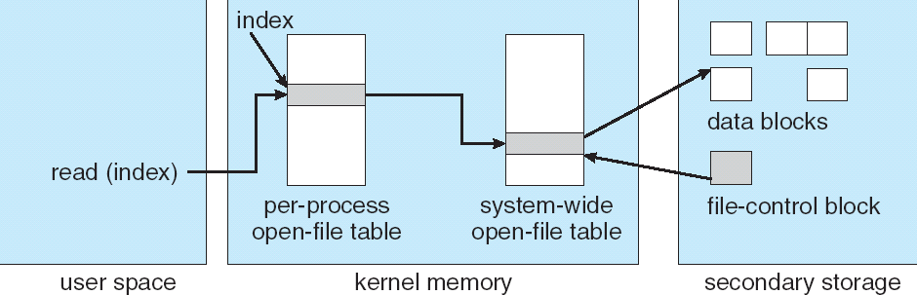
In-Memory File System Structures
71
Read/write system calls:
Use file handle to locate inode
Perform appropriate reads or writes

Slide 72
Towards Copy-on-Write
72
Files are for durable storage AND flexible process-independent, pro tected namespace
Files grow incrementally as written
Update-in-place file systems start with a basic chunk and append (possibly l arger) chunks as file grows
Transition from random access to large sequential
Disks trends: huge and cheap, high startup
Design / Memory trends: cache everything
Reads satisfied from cache, buffer multiple writes and do them all together
Application trends: make multiple related changes to a file and co mmit all or nothing

Slide 73
Emulating COW @ user level
73
Transform file foo to a new version
Open/Create a new file foo.v
where v is the version #
Do all the updates based on the old foo
Reading from foo and writing to foo.v
Including copying over any unchanged parts
Update the link
ln ­f foo foo.v
Does it work?

Slide 74

















Creating a New Version
74
If file represented as a tree of blocks, just need to update the leadi ng fringe
old version
new version
Write

Slide 75














Creating a New Version
75
If file represented as a tree of blocks, just need to update the leadi ng fringe
old version new version
Write

Slide 76
Memory Mapped Files
76
Traditional I/O involves explicit transfers between buffers in process address space to regions of a file
This involves multiple copies into caches in memory, plus system calls
What if we could “map” the file directly into an empty region of our address space
Implicitly “page it in” when we read it
Write it and “eventually” page it out
Executable file is treated this way when we exec the process !!

Slide 77
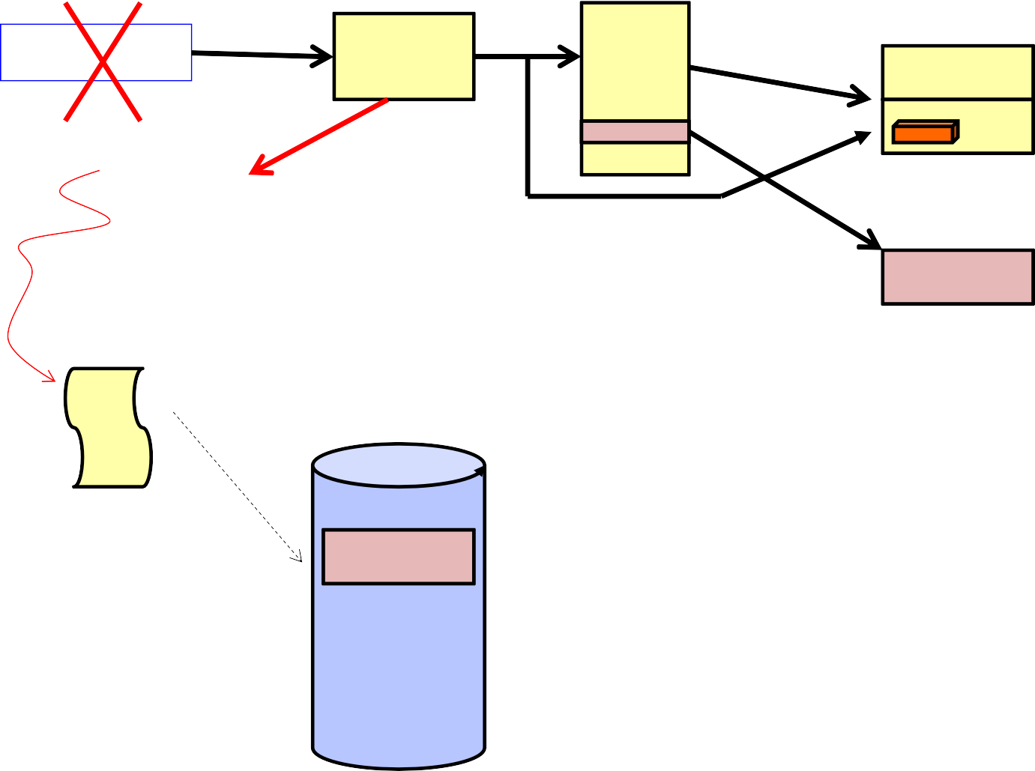
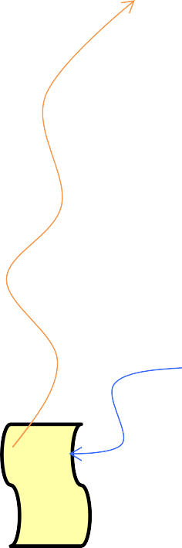
Recall: Who does what when ?
77
Process
virtual address
physical address
instruction
page#
MMU
frame#
PT
retry
exception
page fault
offset
Operating System
Page Fault Handler
update PT entry
load page from disk
scheduler

Slide 78

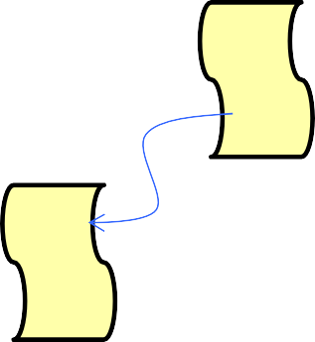
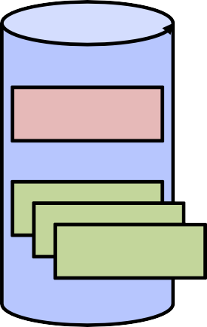
Using Paging to mmap files
78
Process
virtual address
physical address
MMU
page#
PT
instruction
frame#
page fault
offset
Operating System
Create PT entries for mapped region as “backed” by file
Page Fault Handler
File
scheduler
mmap file to region of VAS

Slide 79



Sharing through Mapped Files
79
VAS 1 VAS 2
0x000…
0x000…
instructions
instructions
data
data
File
heap
heap
Memory
stack
stack
OS
OS
0xFFF…
0xFFF…

Slide 80
Log-Structured File system
80

Slide 81
quick review: File Systems
81
A storage management / user interface to stored data
Metadata of a file: i-node structure
File inside OS == i-node
Considers efficient data access for small / large data
Direct blocks, indirect/doubly/triply indirect blocks
Considers security for access control
Permission and credential information
They have to be resident in disk, and memory
Durable after the power-off

Slide 82
Cache & filesystem
82
Huge gap in speed & scale between memory & disk
Latency / throughput
Memory
DDR4 2133 case: 266Mhz, 2133MT/s ~ 17066MB/s
Disk access: several milliseconds for seek time, rotational delay
Bandwidth: 120MB/s
SSD: No seek time, no rotational delay, sub milliseconds
Controller delay & device’s (NAND flash) physical operation time
Bandwidth: up to 500MB/s
Leads to caching

Slide 83
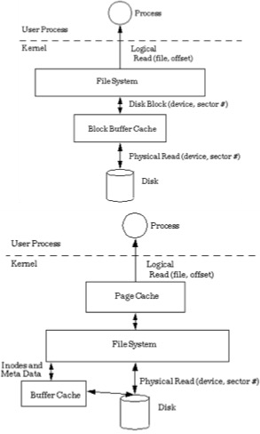
Buffer cache & page cache
83
If we have available space in memory, why not cache data in memory, rather than storing on disk?
Buffer cache!
Caches disk blocks, for faster access
Has to be synchronized with disk blocks
Device driver fetch data block from disk, place it on buffer cache
What’s page cache?
Cache user’s file blocks
Enable faster user access

Slide 84
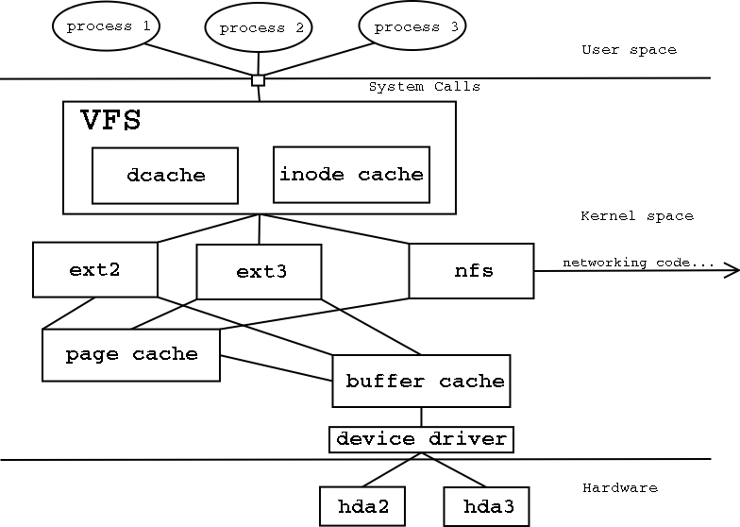
Virtual file system layer
84
To support multiple filesystems, keeping unified user interface
Make a huge function pointers structure
Each file system implements the same interface;
Users are unable to distinguish file system’s operation
Linux VFS layer
Includes separate inode cache, direnty cache, page cache, and buffer cache

Slide 85
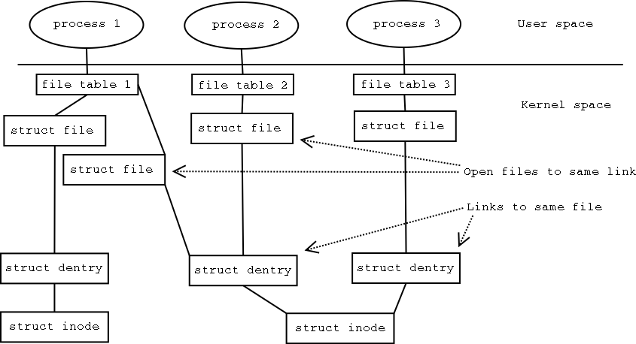
A travel to real FS implementation
85
http://haifux.org/lectures/119/linux-2.4-vfs/linux-2.4-vfs.html

Slide 86
Issues in cache
86
How to find data from cache?
It is a partial set of entire disk, so we cannot find data with index (block number)
Dirty blocks management
Write-through cache vs. write-back cache
Is it okay to store data only on page cache/buffer cache?
No! ➔ you may lose data if you turn off your computer
When the data goes back to disk? / When is good to move your data to disk?
Write permanent data as soon as possible vs. Delay the write as long as possible
What if you have data in buffer cache, and turn off the computer?
Lose data!
How about metadata?

Slide 87
Durability issues – consistency in disk and memory
87
All data in filesystem has to be written back to disk
Disk operation is way slower than memory operations…
About files,
What if we write metadata in the disk, but lost data in the buffer cache?
What if we write data in the disk, but lost metadata in the buffer cache?
What about indirect/doubly indirect blocks update?
About directory files,
What if we update directory entry in the disk, but lost update for the i- node?
What if we update i-node entry in the disk, but lost update for the directory entry?
About free disk blocks,
What if we update free blocks map in the disk, but lost update for i-node?
What if we update i-node in the disk, but lost update for free disk blocks?

Slide 88
More Storage Reliability Problem
88
Single logical file operation can involve updates to multiple physical disk blocks
inode, indirect block, data block, bitmap, …
With remapping, single update to physical disk block can require multiple (even lower level) updates
At a physical level, operations complete one at a time
Want concurrent operations for performance
How do we guarantee consistency regardless of when crash occurs?

Slide 89
Reliability Approach #1: Careful Ordering ⁸⁹
Sequence operations in a specific order
Careful design to allow sequence to be interrupted safely
Post-crash recovery
Read data structures to see if there were any operations in progress
Clean up/finish as needed
Approach taken in FAT, FFS (fsck), and many app-level recovery sch emes
(e.g., Word)

Slide 90
FFS: Create a File
90
Normal operation:
Allocate data block
Write data block
Allocate inode
Write inode block
Update bitmap of free blocks
Update directory with file name
file number
Update modify time for directory
Recovery:
Scan inode table
If any unlinked files (not in any d irectory), delete
Compare free block bitmap agai nst inode trees
Scan directories for missing upd ate/access times
Time proportional to size of disk

Slide 91
Application Level
91
Normal operation:
Write name of each open file to app
folder
Write changes to backup file
Rename backup file to be file (at omic operation provided by file s ystem)
Delete list in app folder on clean shutdown
Recovery:
On startup, see if any files w ere left open
If so, look for backup file
If so, ask user to compare ve rsions

Slide 92
Reliability Approach #2:
Copy on Write-based File System Layout
92
To update file system, write a new version of the file system contai ning the
update
Never update in place
Reuse existing unchanged disk blocks
Seems expensive! But
Updates can be batched
Almost all disk writes can occur in parallel
Approach taken in network file server appliances (WAFL, ZFS)

Slide 93
Transactional processing!
93
Transaction
An atomic sequence of actions (reads/writes) on a storage system (or database)
That takes it from one consistent state to another
transaction
consistent state 1 consistent state 2
Occur all at once (conduct operation completely) or lose all (abort all and go back to old state)
That’s what happened in git, Make some changes and commit!
Commit is the unit of change
Before you commit, the changes are in transient state
If some bad thing happens, roll back to the initial state

Slide 94
The ACID properties of Transactions
94
Atomicity: all actions in the transaction happen, or none happen
Consistency: transactions maintain data integrity, e.g.,
Balance cannot be negative
Cannot reschedule meeting on February 30
Isolation: execution of one transaction is isolated from that of all others; no problems from concurrency
Durability: if a transaction commits, its effects persist despite crashes

Slide 95
Transactional File Systems
95
Journaling File System
Applies updates to system metadata using transactions (using logs, etc.)
Updates to non-directory files (i.e., user stuff) is done in place (without log s)
Ex: NTFS, Apple HFS+, Linux XFS, JFS, ext3, ext4
Logging File System (Log-structured file systems)
All updates to disk are done in transactions
M. Rosenblum, J. Ousterhout, The Design and Implementation of a Log-structured File Sys tem, ACM Trans. of Computer Systems 1992

Slide 96
Logging File Systems
96
Instead of modifying data structures on disk directly, write changes to a
journal/log
Intention list: set of changes we intend to make
Log/Journal is append-only
Once changes are in the log, it is safe to apply changes to data stru ctures on
disk
Recovery can read log to see what changes were intended
Can take our time making the changes
As long as new requests consult the log first
Once changes are copied, safe to remove log
But, …
If the last atomic action is not done … poof … all gone

Slide 97
THE atomic action
97
Write a sector on disk

Slide 98
Redo Logging
98
Prepare
Write all changes (in transaction) to log
Commit
Single disk write to make transact ion durable
Redo
Copy changes to disk
Garbage collection
Reclaim space in log
Recovery
Read log
Redo any operations for committe d transactions
Garbage collect log

Slide 99

Example: Creating a file
99
Find free data block(s)
Find free inode entry
Find dirent insertion point
-------------------------------
Write map (i.e., mark used)
Write inode entry to point to block(s)
Write dirent to point to inode
Free Space map
Data blocks Inode table
…
Directory entries

Slide 100

Ex: Creating a file (as a transaction)
100
Find free data block(s)
Find free inode entry
Find dirent insertion point
-------------------------------
Write map (used)
Write inode entry to point to block(s)
Write dirent to point to inode
tail head
Free Space map
Data blocks Inode table
…
Directory entries
done
pending
start
commit
Log in non-volatile storage (Flash or on Disk)

Slide 101




ReDo log
101
After Commit
All access to file system first looks in log
Eventually copy changes to disk
Free Space map
Data blocks Inode table
…
Directory entries
tail
tail
tail
tail
tail
head
done
start
commit
Log in non-volatile storage (Flash)
pending

Slide 102
Crash during logging - Recover
102
Upon recovery scan the log
Detect transaction start with no commit
Discard log entries
Disk remains unchanged
Free Space map
Data blocks Inode table
…
Directory entries
tail head
done
pending
start
Log in non-volatile storage (Flash or on Disk)

Slide 103
Recovery After Commit
103
Scan log, find start
Find matching commit
Redo it as usual
Or just let it happen later
Free Space map
Data blocks Inode table
…
Directory entries
head
tail
done
pending
start
commit
Log in non-volatile storage (Flash or on Disk)

Slide 104
Questions on Log-structured file system transactions
104
What if had already started writing back the transaction ?
Idempotent ­ the result does not change if the operation is repeat several ti mes.
Just write them again during recovery
What if the uncommitted transaction was discarded on recovery?
Do it again from scratch
Nothing on disk was changed
What if we crash again during recovery?
Idempotent
Just redo whatever part of the log hasn’t been garbage collected

Slide 105
Redo Logging
105
Prepare
Write all changes (in transaction) to log
Commit
Single disk write to make transact ion
durable
Redo
Copy changes to disk
Garbage collection
Reclaim space in log
Recovery
Read log
Redo any operations for committe d transactions
Ignore uncommitted ones
Garbage collect log

Slide 106
Log-structured file system
106
Filesystem operation with transaction
Transaction usages
Reliable application systems (e.g. database)
Logging/commit/rollback
Make a system more reliable than its subsystems
Atomicity to support critical region’s update
2 Phase-Locking
Consistency when multiple users access
Make replicas / log / rollback when it fails
Isolate failure from the rest of the system
Durablity to preserve data after commit
Into the distributed systems

Slide 107
I/O devices and Networking
107

Slide 108
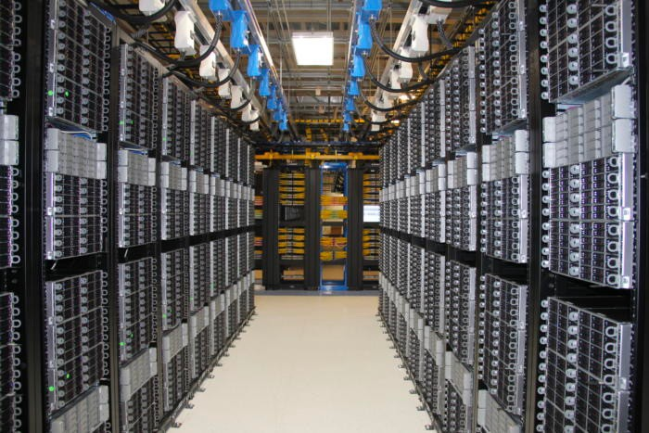
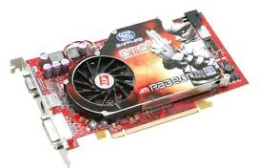
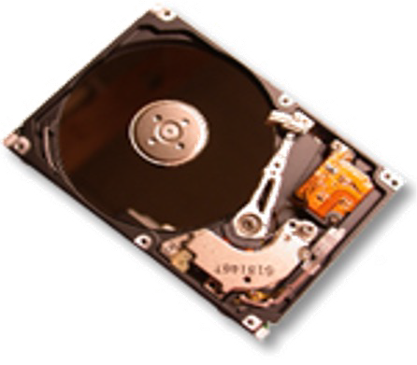

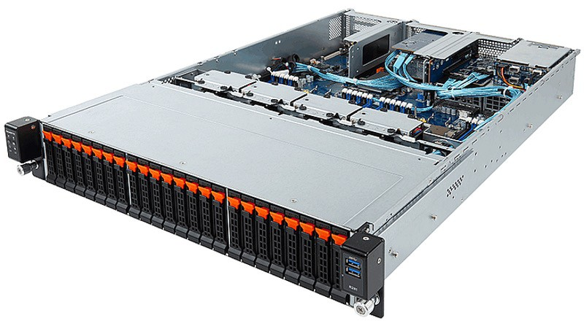
A real world computer system with I/O devices
108
c) Real-life version
Memory
CPU
Interconnect
a) Your view of computer
systems, so far
Memory
CPU
b) Conceptual extension

Slide 109

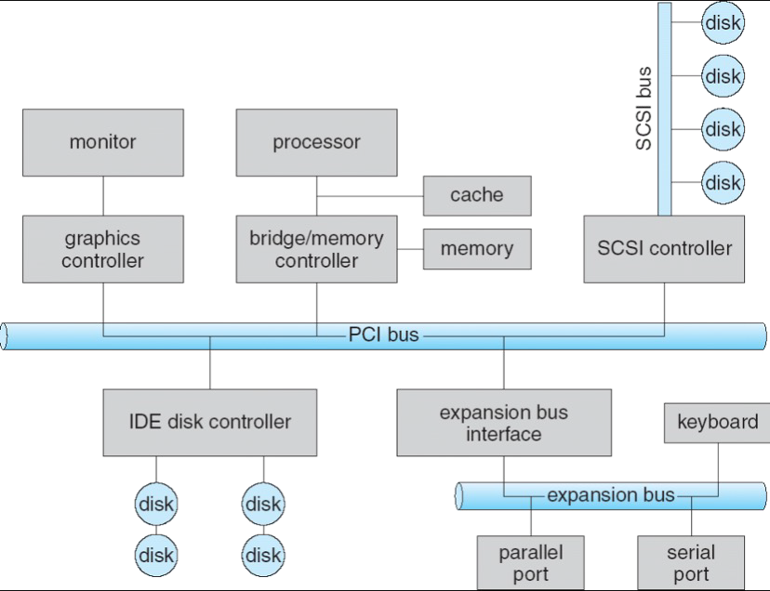
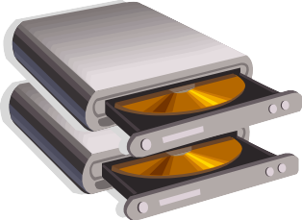

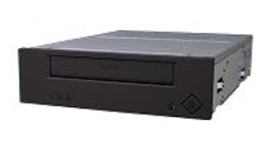

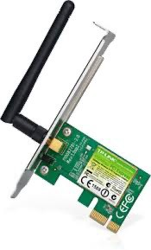


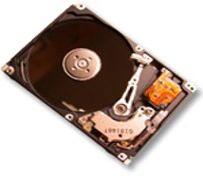





Modern Computer Systems & I/O Devices ¹⁰⁹

Slide 110
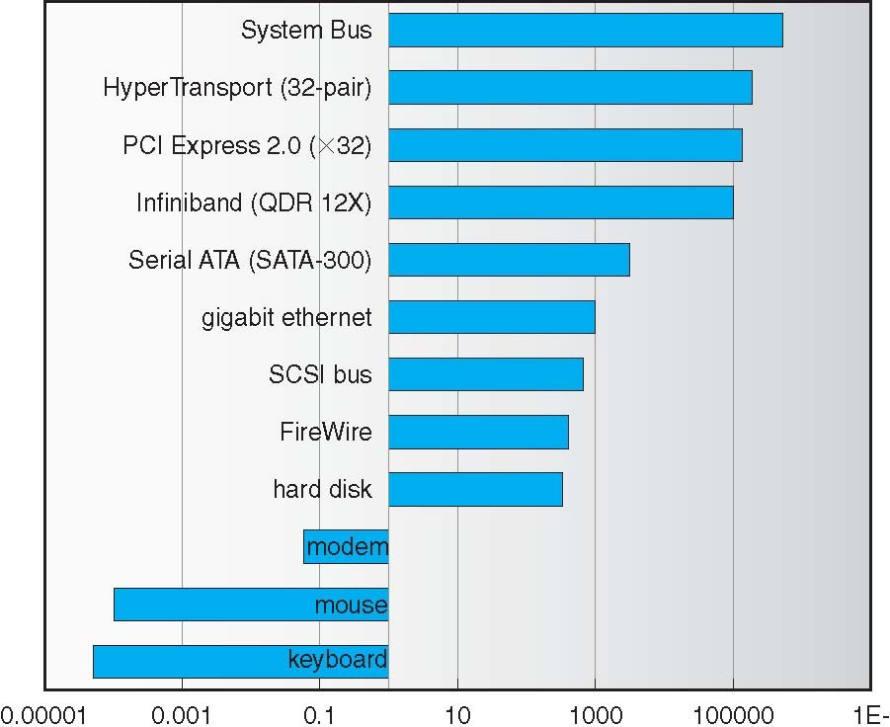
Example Device-Transfer Rates in Mb/s (Sun Enterprise 6000)
110
Device Rates vary over 12 orders of m agnitude !!
System better be able to handle this wide range
Better not have high overhead/byte for fa st devices!
Better not waste time waiting for slow de vices
Rethink the fundamentals
When there is a change / difference in th at scale

Slide 111
I/O devices are small computers!
111
Some complicated I/O devices
NIC (network interface card)
SSD (solid state drive)
HDD (hard disk drive)
Memory
Controller Bit-writing software
Bit- writing hardware
They have special CPU that operates with dedicated hardware
Controller: some form of processing core
Access hardware, instead of calculating numeric values
write value on wire, write value on disk block, read value from disk block
Buffer: some form of memory
Has some data from I/O device and users

Slide 112
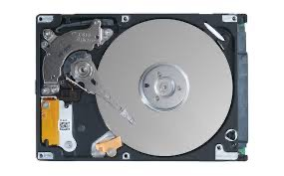
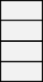


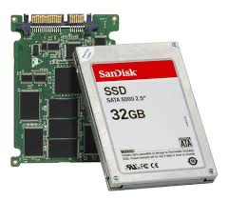



I/O devices operate asynchronous to the CPU execution
112
I/O devices you recognize are supported by I/O Controllers
Processors accesses them by reading and writing IO registers as if t hey were memory
Write commands and arguments, read status and results
Read /
Write
wires
Processor
I/O
_{interrupts} Controllers
Read / Write
DMA transfer
Secondary Storage (Disk)
Main Memory (DRAM)
Secondary Storage (SSD)

Slide 113

How Does the Processor Talk to Devices?
113
CPU interacts with a
Controller
Contains a set of registers that can be read and written
May contain memory for
Processor Memory Bus
Regular Memory
CPU
Bus Adaptor
Bus Adaptor
Device Controller
Address+
Other Devices or Buses
Data
Bus Interface
Hardware Controller
Interrupt Controller
Interrupt Request
request queues or bit-mapped images
read
write
control
status
Addressable Memory and/or Queues
Regardless of the complexity of the connections and buses, processor accesses registers in two ways:
I/O instructions: in/out instructions (e.g., Intel’s 0x21,AL)
Memory mapped I/O: load/store instructions
Registers/memory appear in physical address space
I/O accomplished with load and store instructions
Registers (port 0x20)
Memory Mapped Region: 0x8f008020

Slide 114

Example: Memory-Mapped Display Controller ¹¹⁴
Graphics Command Queue
Display Memory
Command
Status
Memory-Mapped:
Hardware maps control registers and display me mory into physical address space
0x80020000
0x80010000
Addresses set by hardware jumpers or programming at boot time
Simply writing to display memory (also called the
“frame buffer”) changes image on screen
Addr: 0x8000F000—0x8000FFFF
Writing graphics description to command-queue area
0x8000F000
0x0007F004
0x0007F000
Say enter a set of triangles that describe some scene
Addr: 0x80010000—0x8001FFFF
Writing to the command register may cause on- board graphics hardware to do
something
Say render the above scene
Addr: 0x0007F004
Physical Address Space
Can protect with address translation

Slide 115
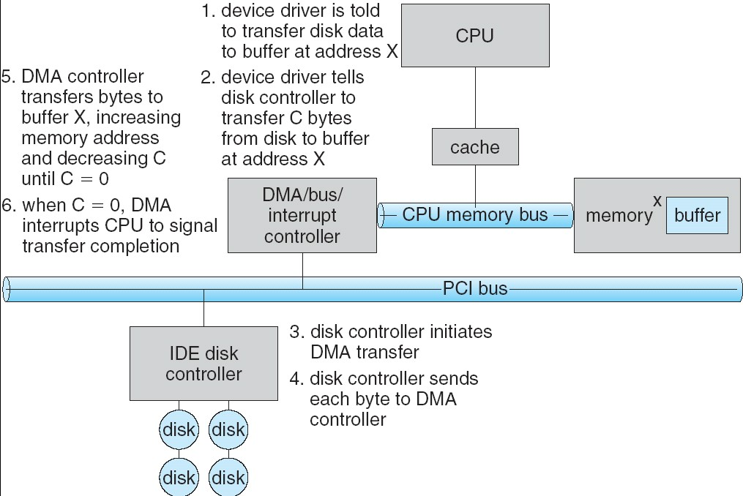
Transferring Data To/From Controller
115
Programmed I/O:
Each byte transferred via processor in/out or load/store
Pro: Simple hardware, easy to
program
Con: Consumes processor cycles proportional to data size
Direct Memory Access:
Give controller access to memory bus
Ask it to transfer data blocks to/from memory directly
Sample interaction with DMA controller
len
addr

Slide 116
I/O Device Notifying the OS
116
The OS needs to know when:
The I/O device has completed an operation
The I/O operation has encountered an error
I/O Interrupt:
Device generates an interrupt whenever it needs service
Pro: handles unpredictable events well
Con: interrupts relatively high overhead
Polling:
OS periodically checks a device-specific status register
I/O device puts completion information in status register
Pro: low overhead
Con: may waste many cycles on polling if infrequent or unpredictable I/O operations
Actual devices combine both polling and interrupts
For instance ­ High-bandwidth network adapter:
Interrupt for first incoming packet
Poll for following packets until hardware queues are empty

Slide 117
What is the Role of I/O?
117
Without I/O, computers are useless (disembodied brains?)
But… thousands of devices, each slightly different
How can we standardize the interfaces to these devices?
Devices are unreliable: media failures and transmission err ors
How can we make them reliable???
Devices are unpredictable and/or slow
How can we manage them if
we don’t know what they will do or how they will perform?

Slide 118
Operational Parameters for I/O
118
Data granularity: Byte vs. Block
Some devices provide single byte at a time (e.g., keyboard)
Others provide whole blocks (e.g., disks, networks, etc.)
Access pattern: Sequential vs. Random
Some devices must be accessed sequentially (e.g., tape)
Others can be accessed “randomly” (e.g., disk, cd, etc.)
Fixed overhead to start sequential transfer (more later)
Transfer Notification: Polling vs. Interrupts
Some devices require continual monitoring
Others generate interrupts when they need service
Transfer Mechanism: Programmed IO and DMA

Slide 119
The Goal of the I/O Subsystem
119
Provide uniform interfaces, despite wide range of different devices
This code works on many different devices:
FILE *fd = fopen(“/dev/something”,“rw”); for (int i = 0; i < 10; i++) {
fprintf(fd, “Count %d\n”,i);
}
close(fd);
Why?
Because code that controls devices (“device driver”) implements standard interface
Standard user library raise the standard driver / subsystem interface
We will try to get a flavor for what is involved in actually controlling devices
Can only scratch surface!

Slide 120
Want Standard Interfaces to Devices
120
Block Devices: e.g., disk drives, tape drives, DVD-ROM
Access blocks of data
Driver Commands include open(), read(), write(), seek()
Raw I/O or file-system access
Memory-mapped file access possible (discussed later … VAS!)
Character/Byte Devices: e.g., keyboards, mice, serial ports, some USB devices
Single characters at a time
Commands include get(), put()
Libraries layered on top allow line editing
Network Devices: e.g., Ethernet, Wireless, Bluetooth
Different enough from block/character to have own interface
Unix and Windows include socket interface
Separates network protocol from network operation
Includes select() functionality

Slide 121

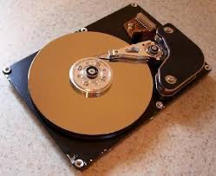
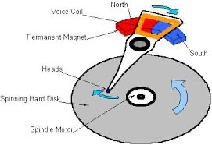
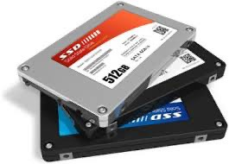

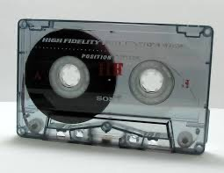
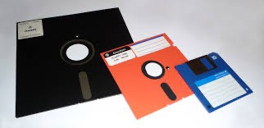
I/O & Storage Layers
121
Operations, Entities and Interface
Application / Service
streams
High Level I/O
Low Level I/O
handles
Syscall
registers
file_open, file_read, … on struct file * & void *
File System
descriptors
open, read, … on ??? (blocks, chars, nets)
I/O Driver
Commands and Data Transfers
Disks, Flash, Controllers, DMA

Slide 122
Basic Performance Concepts
122
Response Time or Latency: Time to perform an operation (s)
Bandwidth or Throughput: Rate at which operations are performed (op/s)
Files: mB/s, Networks: mb/s, Arithmetic: GFLOP/s
Start up or “Overhead”: time to initiate an operation
Most I/O operations are roughly linear
Latency (n) = Ovhd + n/Bandwdth*
Bandwdth* is the bottleneck bandwidth

Slide 123
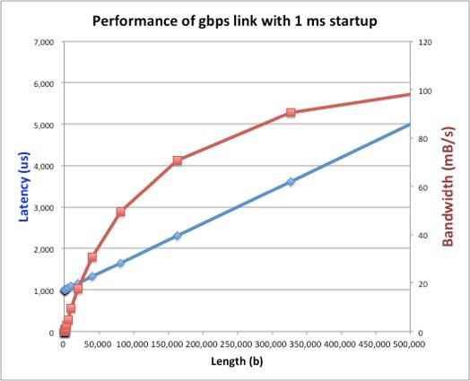
Example (fast network)
123
Consider a 1Gbps link (125 mB/s)
With a startup cost S = 1 ms

Slide 124

Example: at 10 ms startup (disk)
124
Seagate desktop HDD (3TB)
https://www.seagate.com/www- content/product- content/barracuda-fam/desktop- hdd/barracuda-7200-14/en- us/docs/100686584v.pdf
Max I/O data xfer rate 600 MB/s
Average data rate R/W 156MB/s
Average seek time R: 8.5 ms, W:
9.5 ms
Cache buffer 64MB
Performance of gbps link with 10 ms startup
18,000 50
45
40
35
30
25
20
15
10
5
0 0
0 50,000 100,000 150,000 200,000 250,000 300,000 350,000 400,000 450,000 500,000
Length (b)
16,000
14,000
12,000
Bandwidth (mB/s)
Latency (us)
10,000
8,000
6,000
4,000
2,000

Slide 125
What determines peak BW for I/O ?
125
Bus Speed
PCI-X: 1064 MB/s = 133 MHz x 64 bit (per lane)
16GT/s per lane for PCIe v4, Up to 16 lanes or 256GT/s (~31.51GB/s)
IDE: Up to 133MB/s
ULTRA WIDE SCSI: 40 MB/s
Serial Attached SCSI & Serial ATA & IEEE 1394 (firewire) : 1.6 Gbps full duplex (20 0 MB/s)
6Gbit/s for SATA3
USB 1.5 ­ 12 mb/s
10Gbps for USB3.1 Gen2
Device Transfer Bandwidth
Rotational speed of disk
Write / Read rate of nand flash
Signaling rate of network link
Whatever is the bottleneck in the path

Slide 126
Storage Devices
126
Magnetic disks
Storage that rarely becomes corrupted
Large capacity at low cost
Block level random access
Slow performance for random access
Better performance for streaming access
Flash memory
Storage that rarely becomes corrupted
Capacity at intermediate cost (50x disk ???)
Block level random access
Good performance for reads; worse for random writes
Erasure requirement in large blocks
Wear patterns

Slide 127
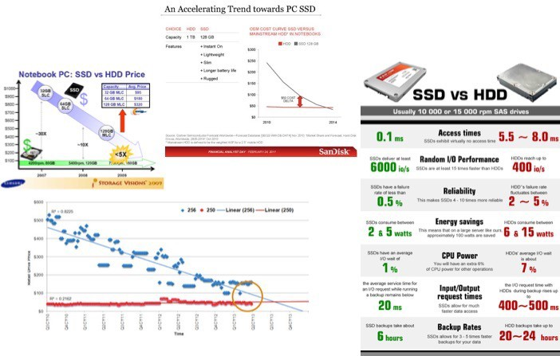
Are we in an inflection point?
127

Slide 128
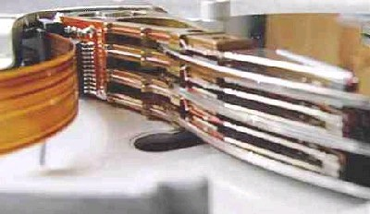
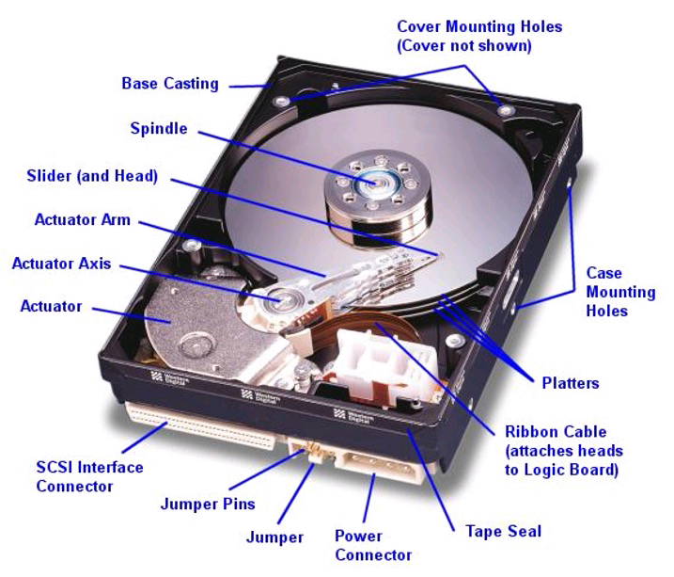
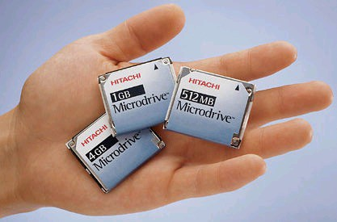
Hard Disk Drives (HDDs)
128
IBM Personal Computer/AT (1986) 30 MB hard disk - $500
30-40ms seek time 0.7-1 MB/s (est.)

Slide 129
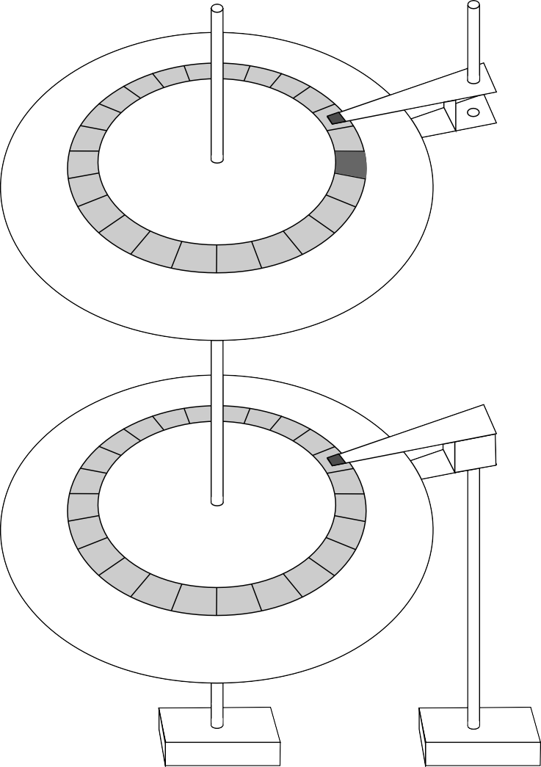
The Amazing Magnetic Disk
129
Unit of Transfer: Sector
Spindle
Head Arm
Ring of sectors form a track
Stack of tracks form a cylinder
Heads position on cylinders
Surface
Platter
Sector
Disk Tracks ~ 1 micron wide
Surface
Wavelength of light is ~ 0.5 micron
Resolution of human eye: 50 microns
100K on a typical 2.5” disk
Track
Arm Assembly
Separated by unused guard regions
Reduces likelihood neighboring tracks are corrupted during writes (still a small non-zero chance)
Track length varies across disk
Outside: More sectors per track, higher bandwidth
Disk is organized into regions of tracks with same # of sectors/track
Only outer half of radius is used
Most of the disk area in the outer regions of the disk
Motor
Motor

Slide 130
Magnetic Disk Characteristic
130
Cylinder: all the tracks under the head at a given point on all surfaces
Read/write: three-stage process:
Seek time: position the head/arm over the proper track (into proper cylinder)
Rotational latency: wait for the desired sector to rotate under the read/write head
Transfer time: transfer a block of bits (sector) under the read-write head
Disk Latency = Queuing Time + Controller time +
Seek Time + Rotation Time + Xfer Time
Sector Track
Cylinder Platter
Head
Request
Software Queue
(Device Driver)
Hardware
Controller
Media Time (Seek+Rot+Xfer)
Result
Highest Bandwidth:
Transfer large group of blocks sequentially from one track

Slide 131
Typical Numbers for Magnetic Disk
131
Parameter | Info / Range
Average seek time | Typically 5-10 milliseconds. Depending on reference locality, actual cost may be 25-33% of this number.
Average rotational latency | Most laptop/desktop disks rotate at 3600-7200 RPM (16-8 ms/rotation). Server disks up to 15,000 RPM. Average latency is halfway around disk yielding corresponding times of 8-4 milliseconds
Controller time | Depends on controller hardware
Transfer time | Typically 50 to 100 MB/s. Depends on: Transfer size (usually a sector): 512B – 1KB per sector Rotation speed: 3600 RPM to 15000 RPM Recording density: bits per inch on a track Diameter: ranges from 1 in to 5.25 in
Cost | Drops by a factor of two every 1.5 years (or even faster). $0.03-0.07/GB in 2013

Slide 132
Intelligence in the controller
132
Sectors contain sophisticated error correcting codes
Disk head magnet has a field wider than track
Hide corruptions due to neighboring track writes
Sector sparing
Remap bad sectors transparently to spare sectors on the same surface
Slip sparing
Remap all sectors (when there is a bad sector) to preserve sequential behav ior
Track skewing
Sector numbers offset from one track to the next, to allow for disk head m ovement for sequential ops
…

Slide 133
Question 1.
133
How long to complete 500 random disk reads, in FIFO order?

Slide 134
134
How long to complete 500 random disk reads, in FIFO ord er?
Seek: average 10.5 msec
Rotation: average 4.15 msec
Transfer: 5-10 usec
500 * (10.5 + 4.15 + 0.01)/1000 = 7.3 seconds

Slide 135
Question 2.
135
How long to complete 500 sequential disk reads?

Slide 136
136
How long to complete 500 sequential disk reads?
Seek Time: 10.5 ms (to reach first sector)
Rotation Time: 4.15 ms (to reach first sector)
Transfer Time: (outer track)
500 sectors * 512 bytes / 128MB/sec = 2ms
Total: 10.5 + 4.15 + 2 = 16.7 ms
Might need an extra head or track switch (+1ms)
Track buffer may allow some sectors to be read off disk out of or der (-2ms)

Slide 137

Solid State Disks (SSDs)
137
1995 – Replace rotating magnetic media with non-volatile memory (battery backe d DRAM)
2009 – Use NAND Multi-Level Cell (2-bit/cell) flash memory
Sector (4 KB page) addressable, but stores 4-64 “pages” per memory block
No moving parts (no rotate/seek motors)
Eliminates seek and rotational delay (0.1-0.2ms access time)
Very low power and lightweight
Limited “write cycles”
Rapid advance in capacity and cost since

Slide 138

SSD Architecture – Reads
138
Read 4 KB Page: ~25 usec
No seek or rotational latency
Transfer time: transfer a 4KB page
SATA: 300-600MB/s =>
~4 x10³ b / 400 x 10⁶ bps => 10 us
Latency = Queuing Time + Controller time + Xfer Time
Highest Bandwidth: Sequential OR Random reads
NAND
NAND
NAND NAND
NAND
NAND
NAND NAND
NAND
NAND
NAND NAND
NAND
NAND
NAND NAND
Buffer Manager (software Queue)
Flash Memory Controller
NAND
NAND
NAND NAND
NAND
NAND
NAND NAND
Host
SATA
NAND
NAND
NAND NAND
NAND
NAND
NAND NAND
DRAM

Slide 139

SSD Architecture – Writes (I)
139
Writing data is complex! (~200μs – 1.7ms )
Can only write empty pages in a block
Erasing a block takes ~1.5ms
Controller maintains pool of empty blocks by coalescing used pages (read, erase, write),
also reserves some % of capacity
Rule of thumb: writes 10x reads, era sure 10x writes
https://en.wikipedia.org/wiki/Solid-state_drive

Slide 140
SSD Summary
140
Pros (vs. hard disk drives):
Low latency, high throughput (eliminate seek/rotational delay)
No moving parts:
Very light weight, low power, silent, very shock insensitive
Read at memory speeds (limited by controller and I/O bus)
Cons
Small storage (0.1-0.5x disk), expensive (20x disk ???)
Hybrid alternative: combine small SSD with large HDD
Asymmetric block write performance: read pg/erase/write pg
Controller garbage collection (GC) algorithms have major effect on performance
Limited drive lifetime
1-10K writes/page for MLC NAND
Avg failure rate is 6 years, life expectancy is 9–11 years
These are changing rapidly

Slide 141
I/O and System Performance
141

Slide 142
I/O Performance
142
Controller
User Thread
Response Time (ms)
I/O device
300
Queue [OS Paths]
200
Response Time = Queue + I/O device service time
Performance of I/O subsystem
Metrics: Response Time, Throughput
Effective BW per op = transfer size / response time
100
0
0%
100%
Throughput (Utilization) (% total BW)
EffBW(n) = n / (S + n/B) = B / (1 + SB/n )
Contributing factors to latency:
Software paths (can be loosely modeled by a queue)
Hardware controller
I/O device service time
Queuing behavior:
Can lead to big increases of latency as utilization increases
Solutions?

Slide 143













A Simple Deterministic World
143
arrivals
Queue
Server
departures
T _{Q}
T _{S}
T _{A}
T _{A}
T _{A}
Assume requests arrive at regular intervals, take a fixed time to process, with plenty o f time between …
Service rate (μ = 1/T _{S}) - operations per sec
Arrival rate: (λ = 1/T _{A}) - requests per second
Utilization: U = λ/μ , where λ < μ
Average rate is the complete story

Slide 144









An Ideal Linear World
144
Saturation
Delivered Throughput
1
Delivered Throughput
1
Empty Queue
Unbounded
0
1
0
1
Offered Load (T_{A}/T_{S})
Offered Load (T_{A}/T_{S})
Queue delay
Queue delay
time
time
What does the queue wait time look like?
Grows unbounded at a rate ~ (T_{s}/T_{A}) till request rate subsides

Slide 145















A Bursty World
145
arrivals
Queue
Server
departures
T _{Q}
T _{S}
Arrivals
Q depth
Server
Requests arrive in a burst, must queue up till served
Same average arrival time, but almost all of the requests experience large queue delays
Even though average utilization is low

Slide 146



So how do we model the burstiness?
146
Elegant mathematical framework if you start with exponential distri bution
Probability density function of a continuous random variable with a mean o
f 1/λ
f(x) = λe^{-λx}
“Memoryless”
Likelihood of an event occuring is independent of how long we’ve been waiting
1
0.9
0.8
0.7
0.6
mean arrival interval (1/λ)
0.5
0.4
Lots of short arrival intervals (i.e., high instantaneous rate)
Few long gaps (i.e., low instantaneous rate)
0.3
0.2
0.1
0
0
2
4
x (λ)
6
8
10

Slide 147



How Long should we expect to wait?
147
RespTime = ServTime * 1/(1-U)
Better if gaussian (spread around the mean)
Variance in R = S/(1-U)²
Response Time vs. Utilization
Response Time
Service Time
0
Utilization
1

Slide 148





Little’s Law
148
N
arrivals
departures
B
L
In any stable system
Average arrival rate = Average departure rate
the average number of tasks in the system (N) is equal to the throu ghput (B) times the response time (L)
N (ops) = B (ops/s) x L (s)
Regardless of structure, bursts of requests, variation in service
instantaneous variations, but it washes out in the average
Overall requests match departures

Slide 149
I/O Performance
149
Solutions?
Make everything faster ©
More Decoupled (Parallelism) systems
multiple independent buses or controllers
Optimize the bottleneck to increase service rate
Use the queue to optimize the service
Do other useful work while waiting
300
Response Time (ms)
200
100
0
0%
100%
Throughput (Utilization) (% total BW)
Queues absorb bursts and smooth the flow
Admissions control (finite queues)
Controller
User Thread
I/O device
Queue [OS Paths]
Limits delays, but may introduce unfairness and livelock
Response Time = Queue + I/O device service time

Slide 150
Ex: Disk Performance Examples
150
Assumptions:
Ignoring queuing and controller times for now
Avg seek time of 5ms,
7200RPM ⇒ Time for one rotation: 60000ms/7200 ~= 8ms
Transfer rate of 4MByte/s, sector size of 1 KByte
Read sector from random place on disk:
Seek (5ms) + Rot. Delay (4ms) + Transfer (0.25ms)
Approx 10ms to fetch/put data: 100 KByte/sec
Read sector from random place in same cylinder:
Rot. Delay (4ms) + Transfer (0.25ms)
Approx 5ms to fetch/put data: 200 KByte/sec
Read next sector on same track:
Transfer (0.25ms): 4 MByte/sec
Key to using disk effectively (especially for file systems) is to minimize seek and rotational delays

Slide 151
Disk Scheduling
151
Disk can do only one request at a time; What order do you choose to do queu ed requests?
Request denoted by (track, sector)
User Requests
Scheduling algorithms:
2,2 | 5,2 | 7,2 | 3,10 | 2,1 | 2,3
Head
Disk Head
First In First Out (FIFO)
Shortest Seek Time First
SCAN
C-SCAN
In our examples we ignore the sector
Consider only track #
3
2
1
4

Slide 152

FIFO: First In First Out
152
Schedule requests in the order the y arrive in the queue
Disk Head
6
5
4
3
2
1
Example:
Request queue: 2, 1, 3, 6, 2, 5
Scheduling order: 2, 1, 3, 6, 2, 5
16 tracks, 6 seeks
Pros: Fair among requesters
Cons: Order of arrival may be to r
andom spots on the disk ⇒ Very l ong seeks

Slide 153

SSTF: Shortest Seek Time First
153
Pick the request that’s closest to the head on the disk
Although called SSTF, include rotational delay in calculation, as rotation can be as long as seek
Disk Head
6
5
4
3
2
1
Example:
Request queue: 2, 1, 3, 6, 2, 5
Scheduling order: 5, 6, 3, 2, 2, 1
6 tracks, 4 seeks
Pros: reduce seeks
Cons: may lead to starvation
Greedy. Not optimal

Slide 154

SCAN
154
Implements an Elevator Algorithm: take the closest request in the direction of travel
Disk Head
6
5
4
3
2
1
Example:
Request queue: 2, 1, 3, 6, 2, 5
Head is moving towards center
Scheduling order: 5, 3, 2, 2, 1, 6
8 tracks, 4 seeks
Pros:
No starvation
Low seek
Cons: favors middle tracks
May spend time on sparse tracks while dense requests elsewhere

Slide 155

C-SCAN
155
Like SCAN but only serves request in only one direction
Disk Head
Example:
Request queue: 2, 1, 3, 6, 2, 5
Head only serves request on its way from center towards edge
Scheduling order: 5, 6, 1, 2, 2, 3
8 tracks, 5 seeks
6
5
4
3
2
1
Pros:
Fairer than SCAN
Accumulate work in remote region then go get it
Cons: longer seeks on the way back
Optimization: dither to pickup nearby requests as you go

Slide 156
When is the disk performance highest
156
When there are big sequential reads, or
When there is so much work to do that they can be piggy backed (c-scan)
OK, to be inefficient when things are mostly idle
Bursts are both a threat and an opportunity
<your idea for optimization goes here>
Waste space for speed?

Slide 157
How do we hide I/O latency?
157
Blocking Interface: “Wait”
When request data (e.g., read() system call), put process to sleep until data is ready
When write data (e.g., write() system call), put process to sleep until device is ready fo r data
Non-blocking Interface: “Don’t Wait”
Returns quickly from read or write request with count of bytes successfully transferred to kernel
Read may return nothing, write may write nothing
Asynchronous Interface: “Tell Me Later”
When requesting data, take pointer to user’s buffer, return immediately; later kernel fil ls buffer and notifies user
When sending data, take pointer to user’s buffer, return immediately; later kernel takes data and notifies user

Slide 158
Kernel vs User-level I/O
158
Both are popular/practical for different reasons:
Kernel-level drivers for critical devices that must keep running, e.g. display drivers.
Programming is a major effort, correct operation of the rest of the kernel depends on correct driver operation.
User-level drivers for devices that are non-threatening, e.g USB devices in Linux (libu sb).
Provide higher-level primitives to the programmer, avoid every driver doing low-level I/O register t weaking.
The multitude of USB devices can be supported by Less-Than-Wizard programmers.
New drivers don’t have to be compiled for each version of the OS, and loaded into the kernel.

Slide 159
Kernel vs User-level Programming Styles
159
Kernel-level drivers
Have a much more limited set of resources available:
Only a fraction of libc routines typically available.
Memory allocation (e.g. Linux kmalloc) much more limited in capacity and required to be physicall y contiguous.
Should avoid blocking calls.
Can use asynchrony with other kernel functions but tricky with user code.
User-level drivers
Similar to other application programs but:
Will be called often – should do its work fast, or postpone it – or do it in the background.
Can use threads, blocking operations (usually much simpler) or non-blocking or asynchronous.

Slide 160
Some performance guidance
160
Concurrency and Parallelism
Make I/O work asynchronous to CPU jobs
Make your cpu cores busy
Thread-level parallelism
Avoid copy as much as possible
share page with control
batch jobs for reduce per-transaction overhead
trade throughput with latency, if you want
Consider cache and memory hierarchy
Compiler and Symbolic execution
ref_google Performance engineering for software systems

Slide 161
Mini-lab.
161

